Slide 1

APRIORI ALGORITHM
CS 634
DATA MINING
Advance Implementation Project
Project By: Under Professor: Charanpreet Kaur Dhir Jason Wang
(ckd22@njit.edu) (wangj@njit.edu)
Notes:
Font – Mismatched font
Font – Resize title to include larger font size

Slide 2
HITS ALGORITHM
Hyperlink-Induced Topic Search (HITS; also known as hubs and authorities) is a link analysis algorithm that rates Web pages, developed by Jon Kleinberg.
The idea behind Hubs and Authorities stemmed from a particular insight into the creation of web pages when the Internet was originally forming; that is, certain web pages, known as hubs, served as large directories that were not actually authoritative in the information that they held, but were used as compilations of a broad catalog of information that led users direct to other authoritative pages.]
Notes:
Title – The title is aligned right and the first letter of each word should be upper case.
Too much text – edit text to remove unnecessary verbiage.
Spelling/Grammar – fix “lett” and weather
Body Text – switch to a sans serif font – adjust size

Slide 3
Goal of The Project: Using search engine to search for 30 web pages related to “Deep Learning.’’ Creating a root set that contains the 30 web pages, called seed pages. The root set is then expanded to a base set or neighborhood graph, by adding all of the pages that the root-set pages link to, and all of the pages that link to a page in the root set, up to a size cutoff threshold k where k is a user-specified parameter value. Each page in the neighborhood graph is initially assigned an authority weight of 1 and a hub weight of 1. Then we used the HITS algorithm to iteratively update the authority weight and hub weight and then normalize the algorithm so that the weights converge.

Slide 4
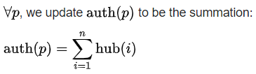
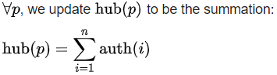
Algorithm :
We consider two types of updates: Authority Update Rule and Hub Update Rule. In order to calculate the hub/authority scores of each node, repeated iterations of the Authority Update Rule and the Hub Update Rule are applied. A k-step application of the Hub-Authority algorithm entails applying for k times first the Authority Update Rule and then the Hub Update Rule.
Authority update rule
where n is the total number of pages connected to p and i is a page connected to p. That is, the Authority score of a page is the sum of all the Hub scores of pages that point to it.
Hub update rule
where n is the total number of pages p connects to and i is a page which p connects to. Thus a page's Hub score is the sum of the Authority scores of all its linking pages

Slide 5
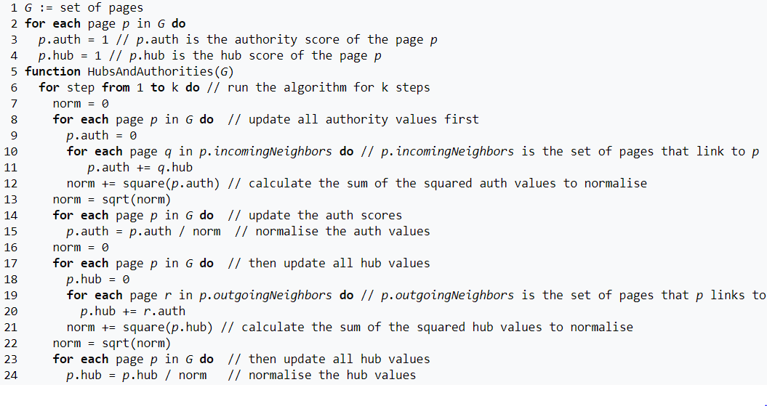
Normalization
The final hub-authority scores of nodes are determined after infinite repetitions of the algorithm. As directly and iteratively applying the Hub Update Rule and Authority Update Rule leads to diverging values, it is necessary to normalize the matrix after every iteration. Thus the values obtained from this process will eventually converge.
Pseudocode
The hub and authority values converge in the pseudocode below.

Slide 6
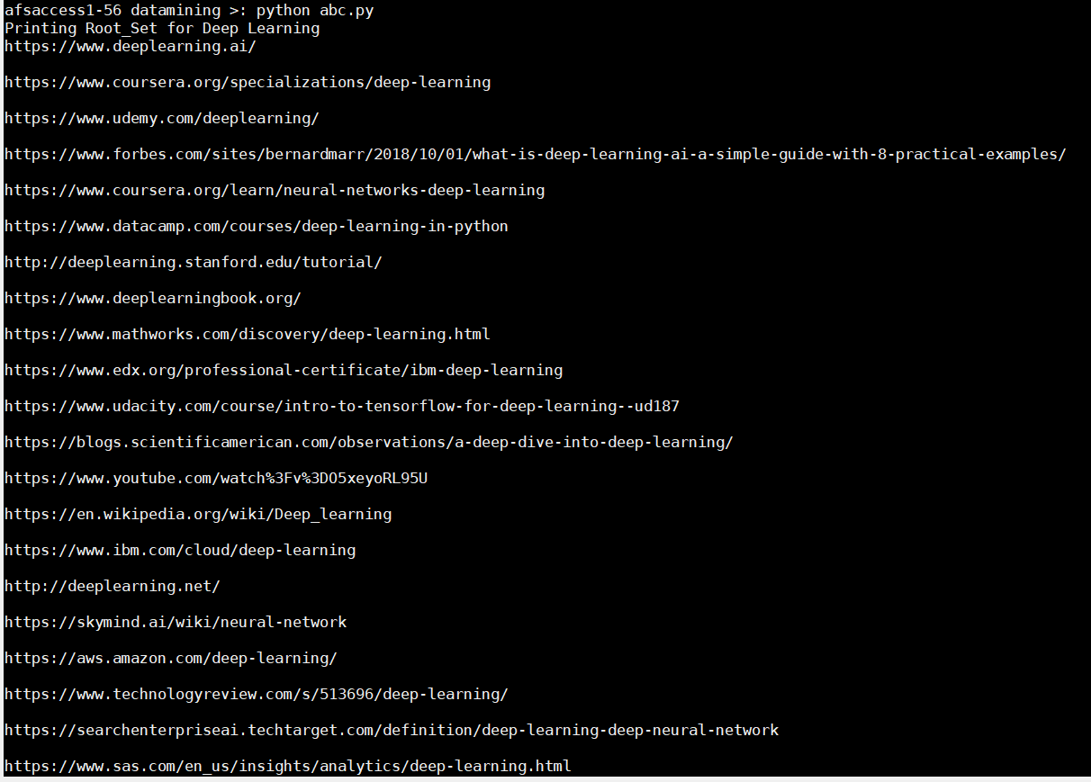
Root and Neighborhood set related to Deep Learning

Slide 7
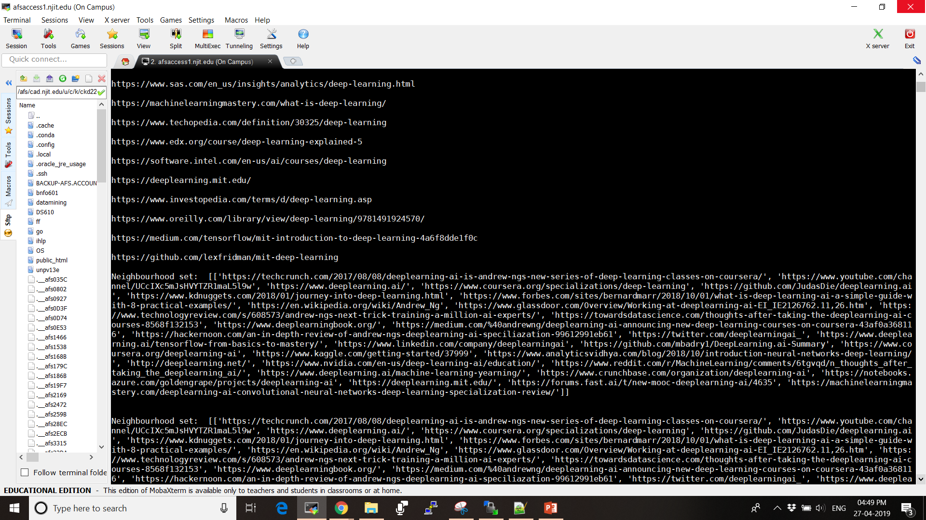

Slide 8
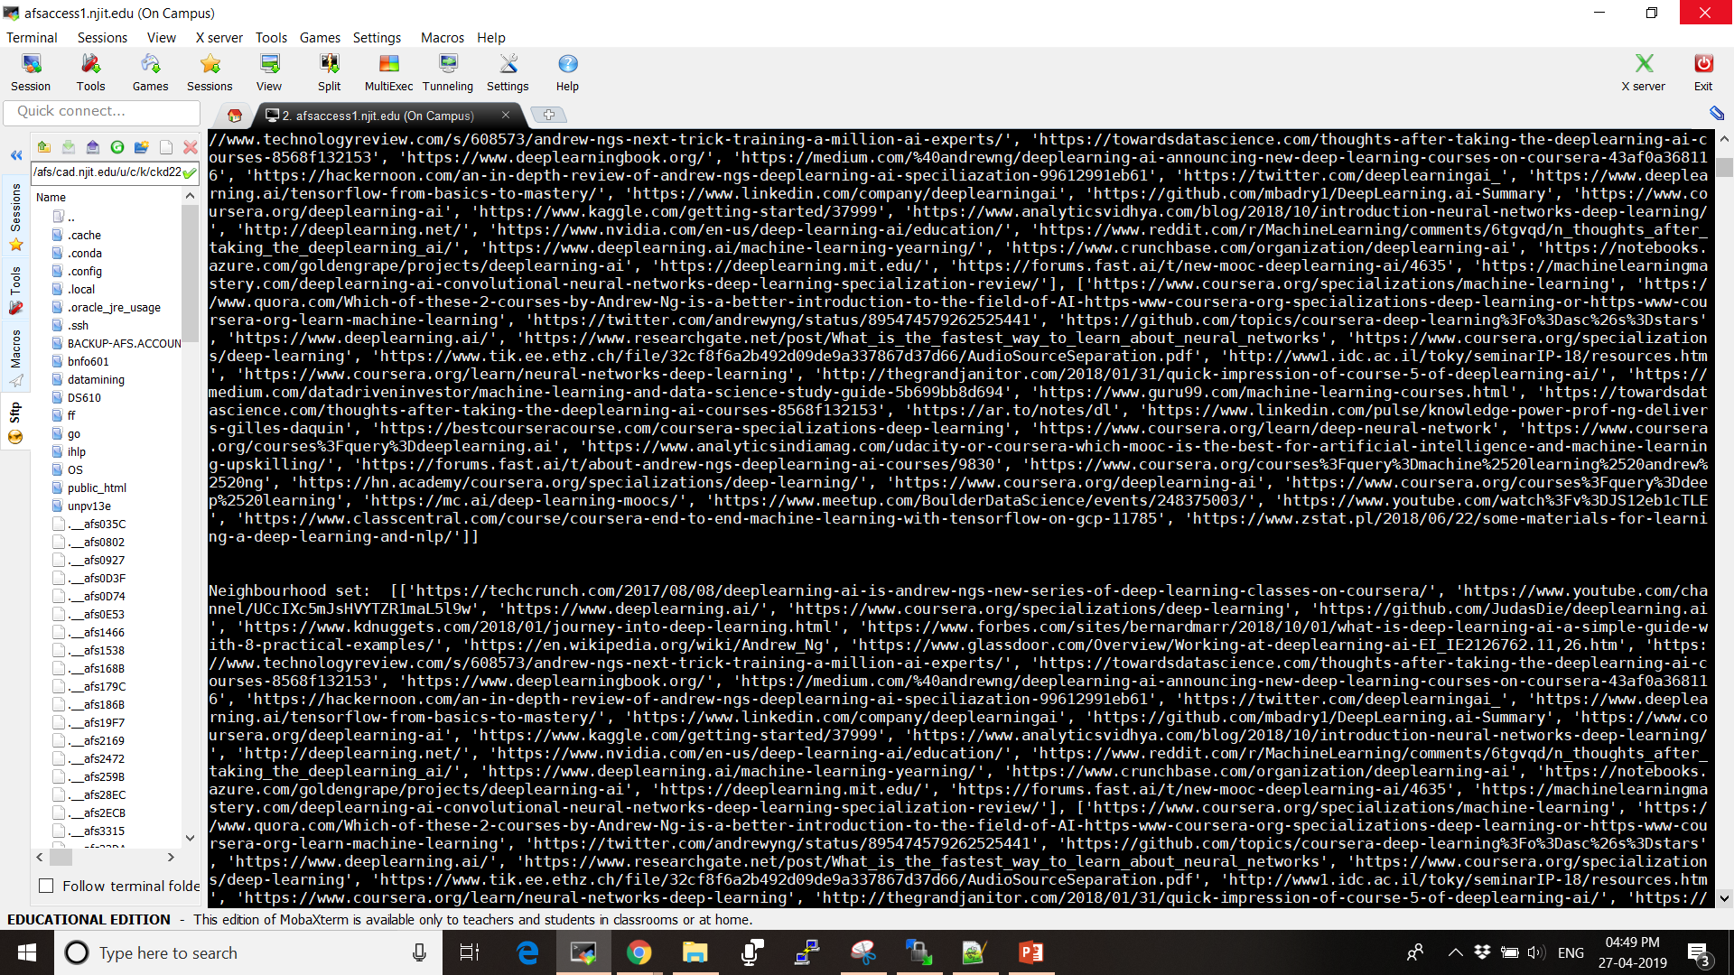

Slide 9
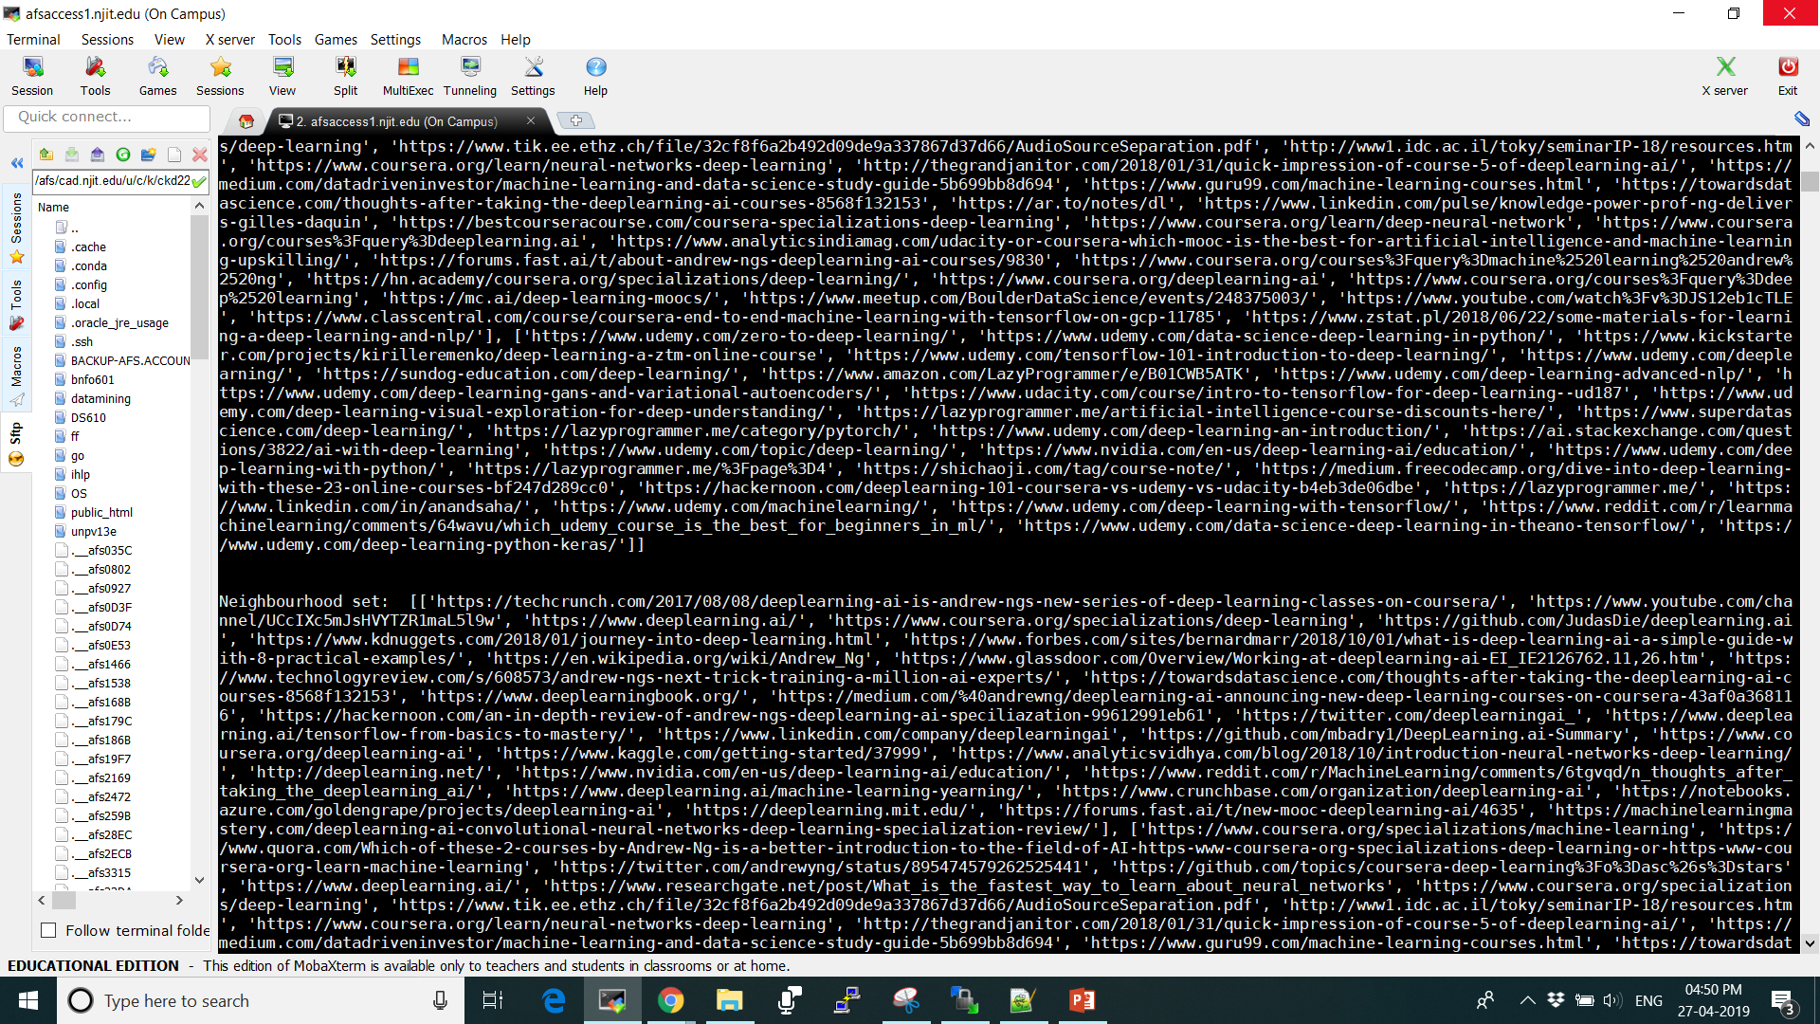
In between lots of neighborhood pages links

Slide 10
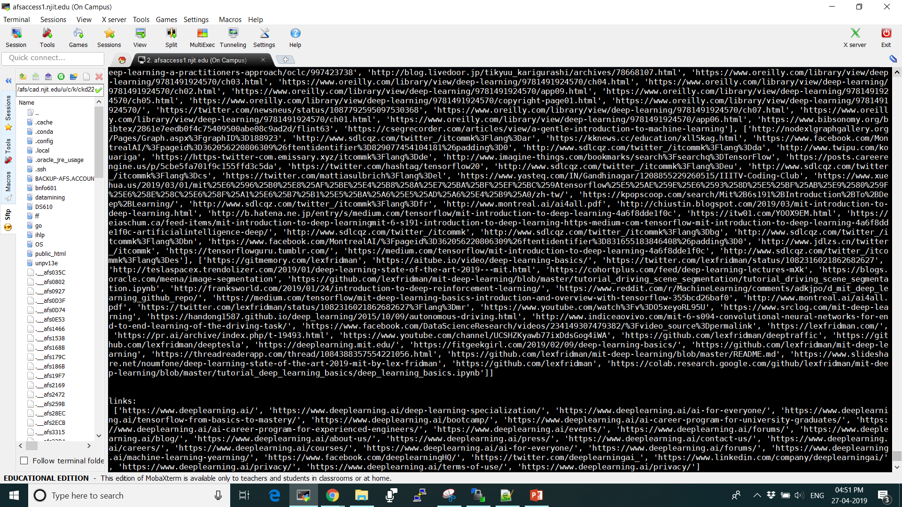

Slide 11
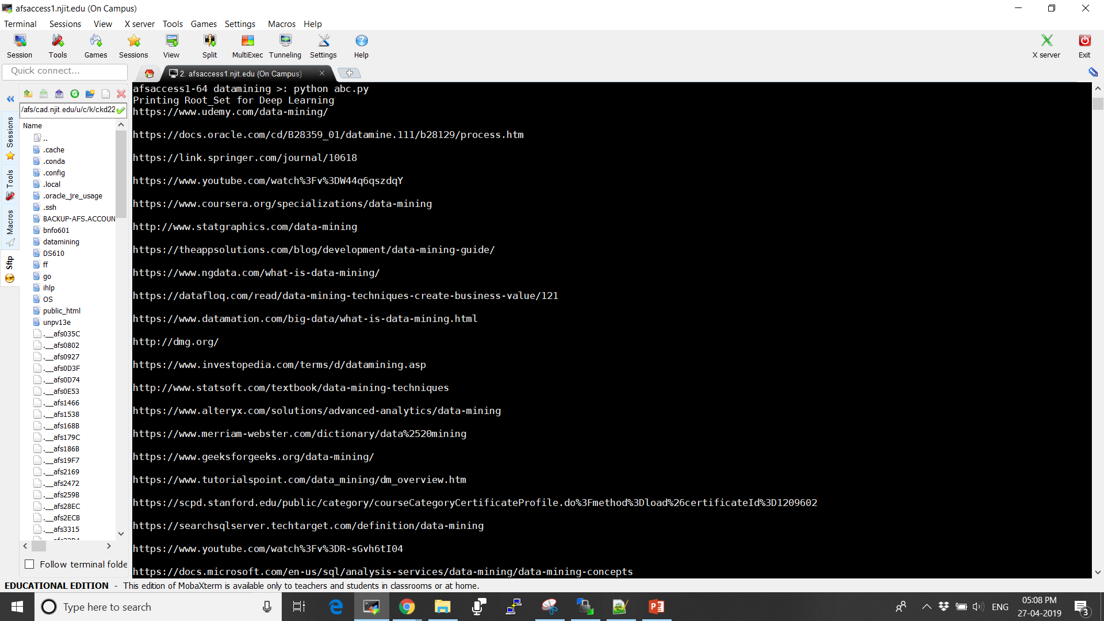
Root and Neighborhood set related to Data Mining

Slide 12
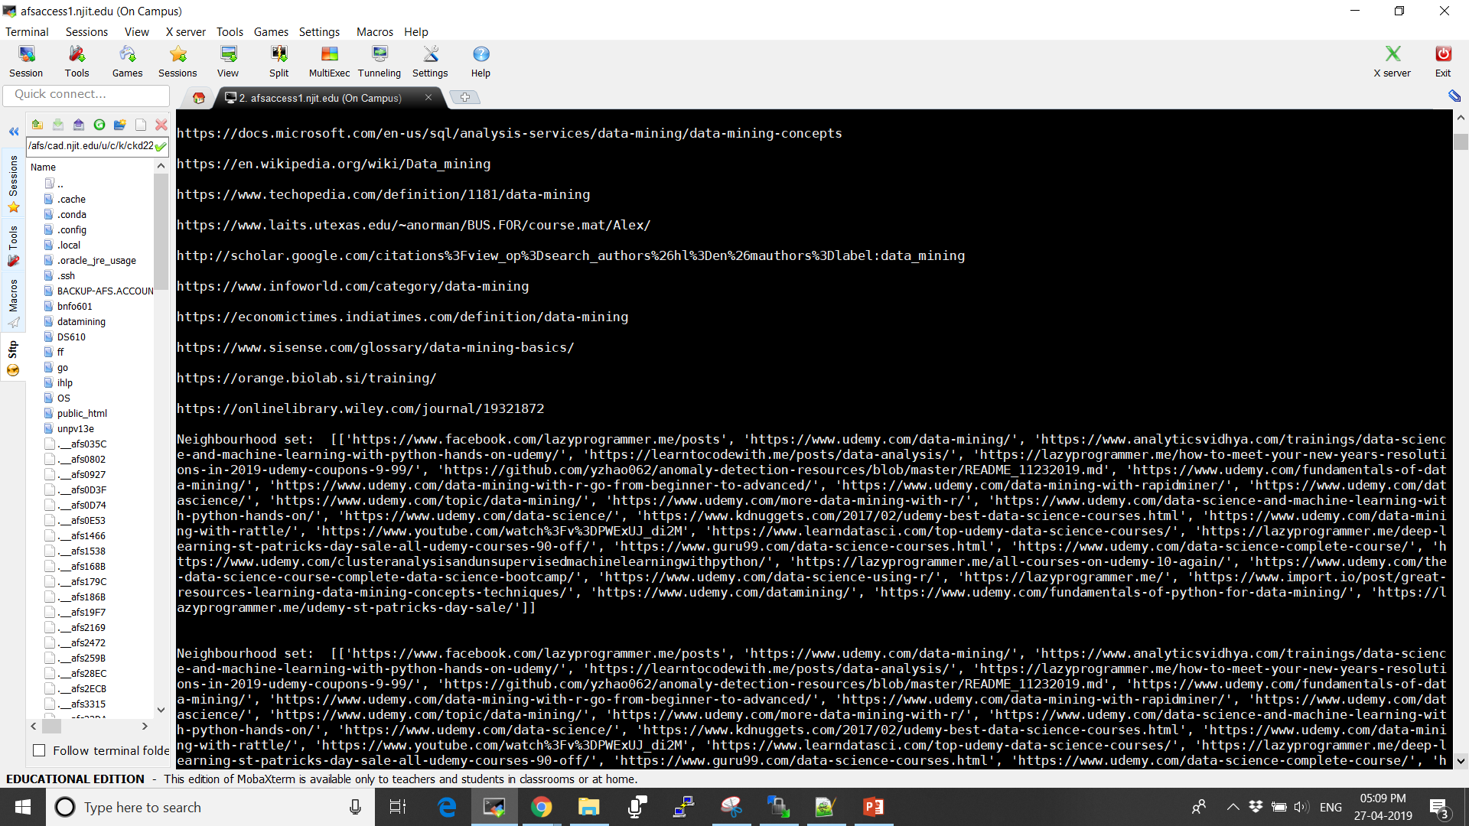

Slide 13
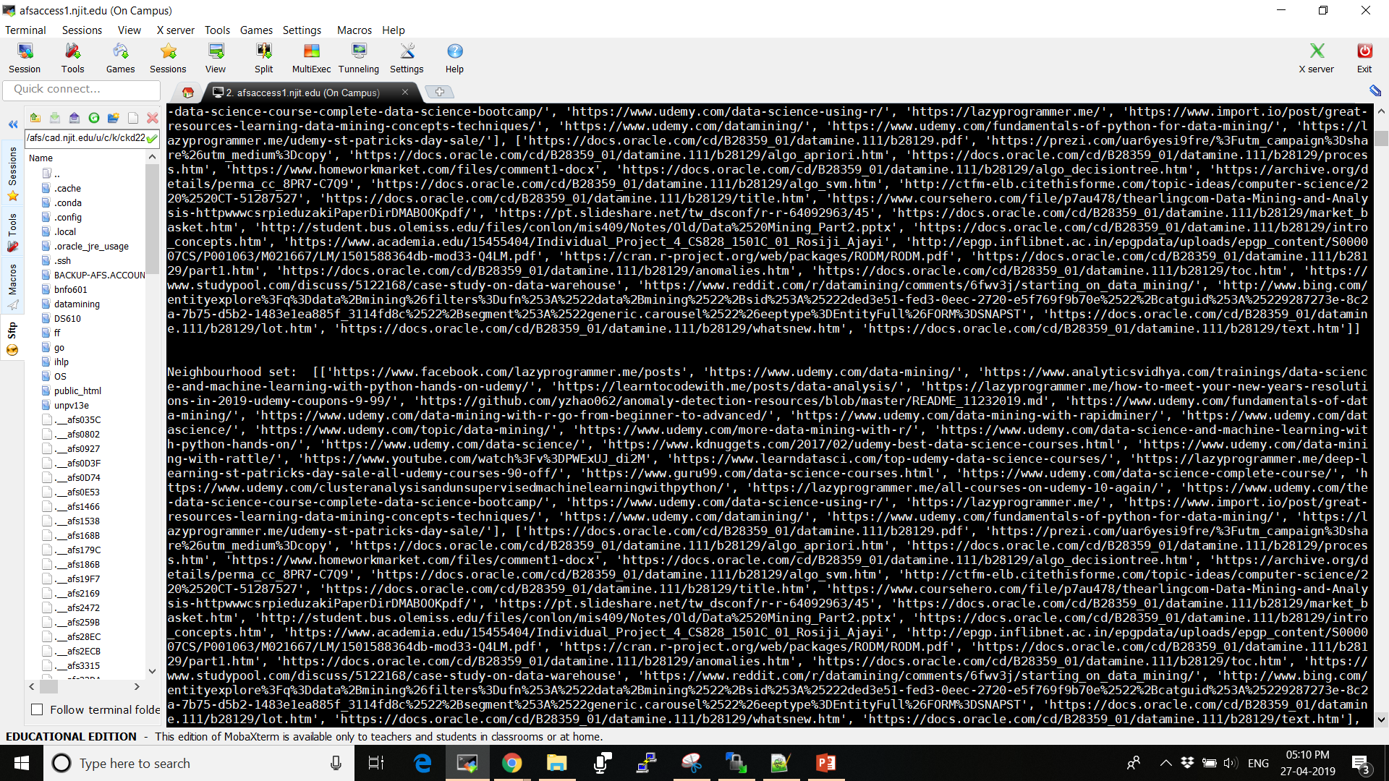
In between lots of neighborhood pages links

Slide 14
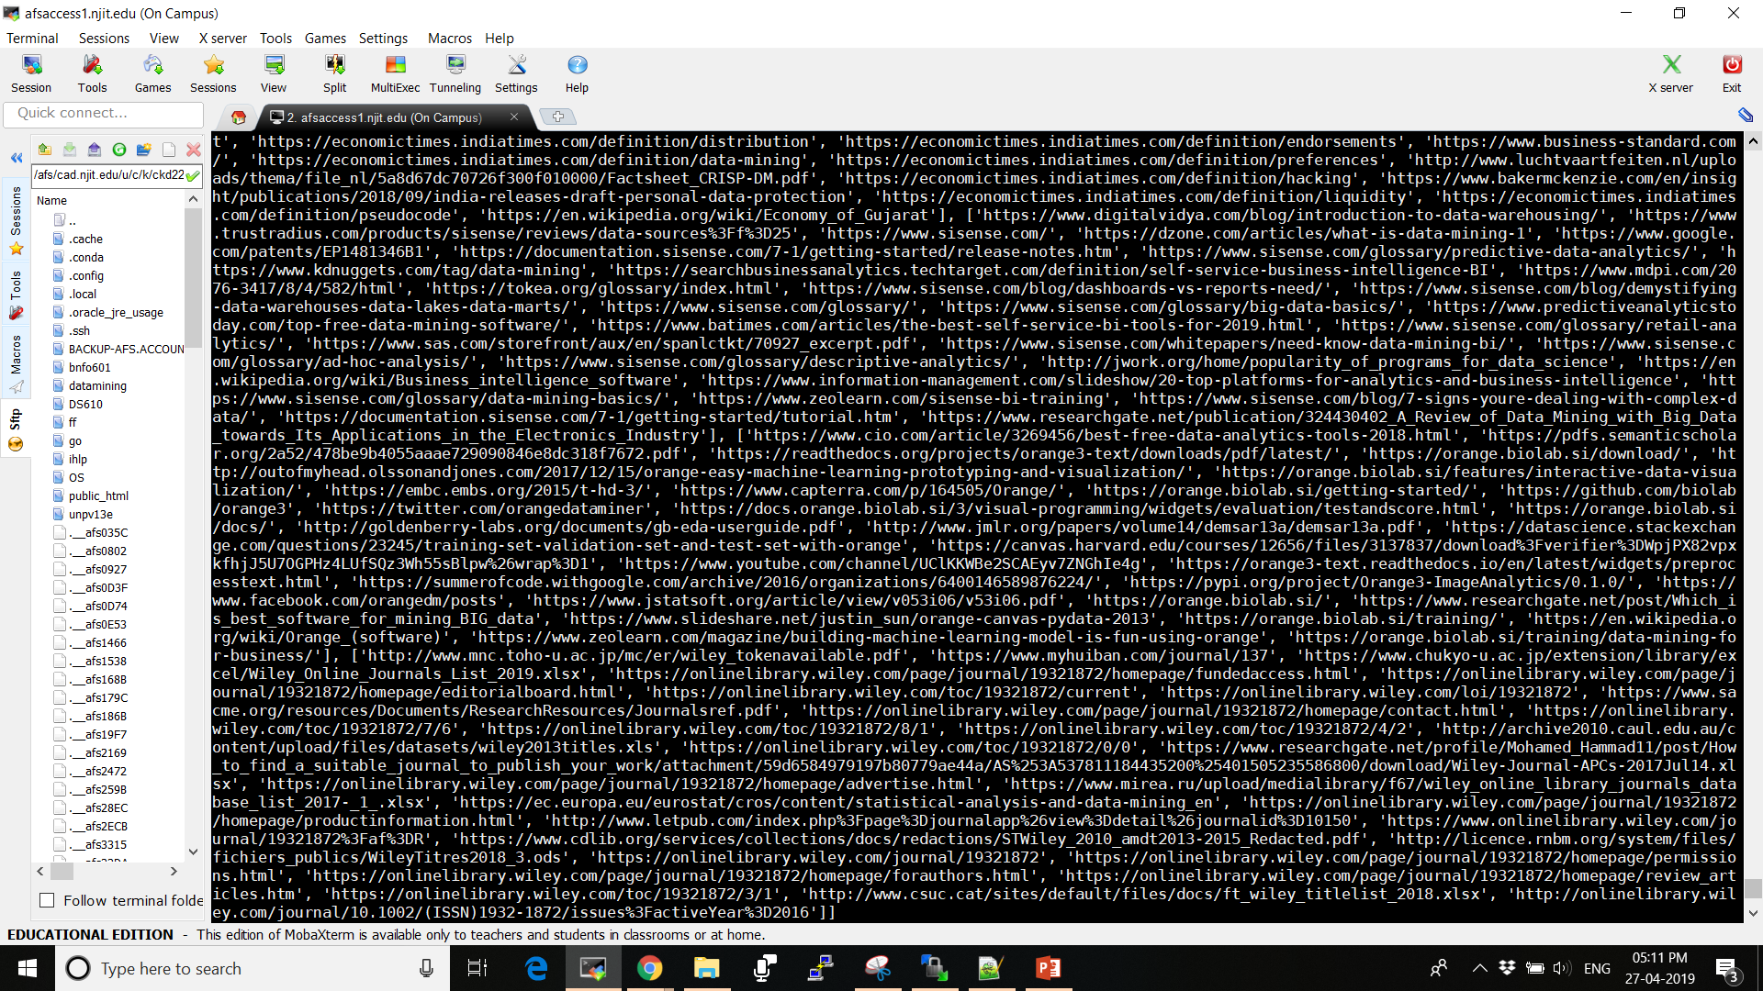

Slide 15
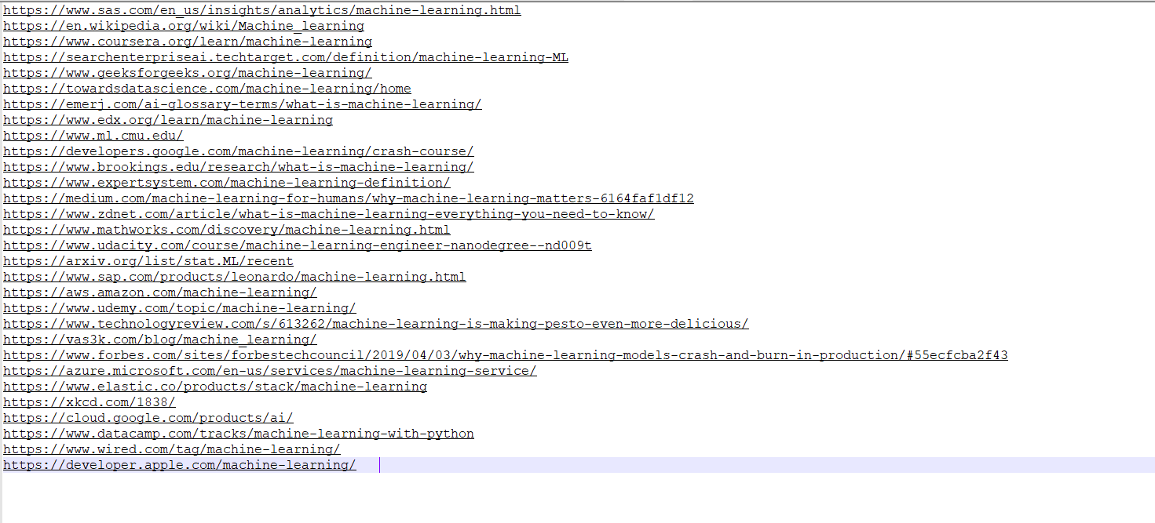
Root set related to Machine Learning

Slide 16
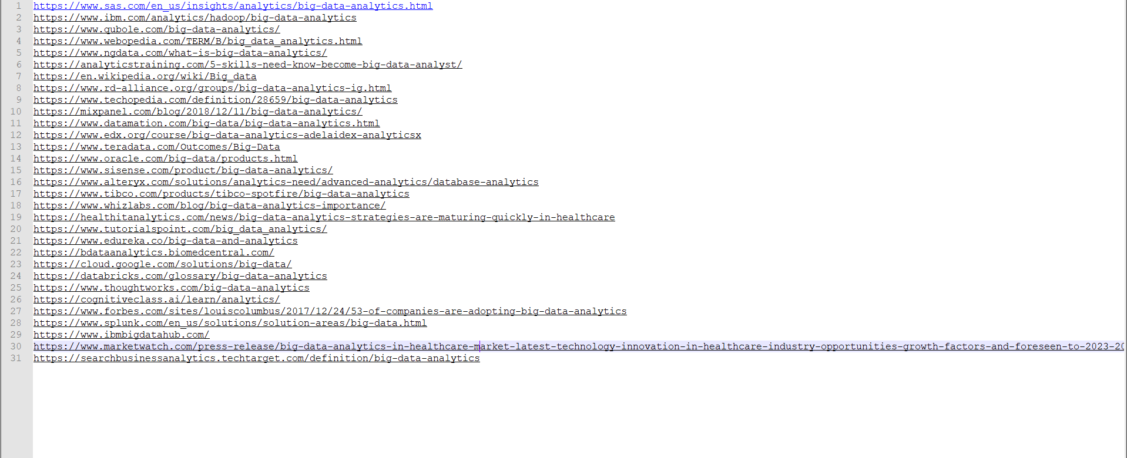
Root set related to Big Data Analytics

Slide 17
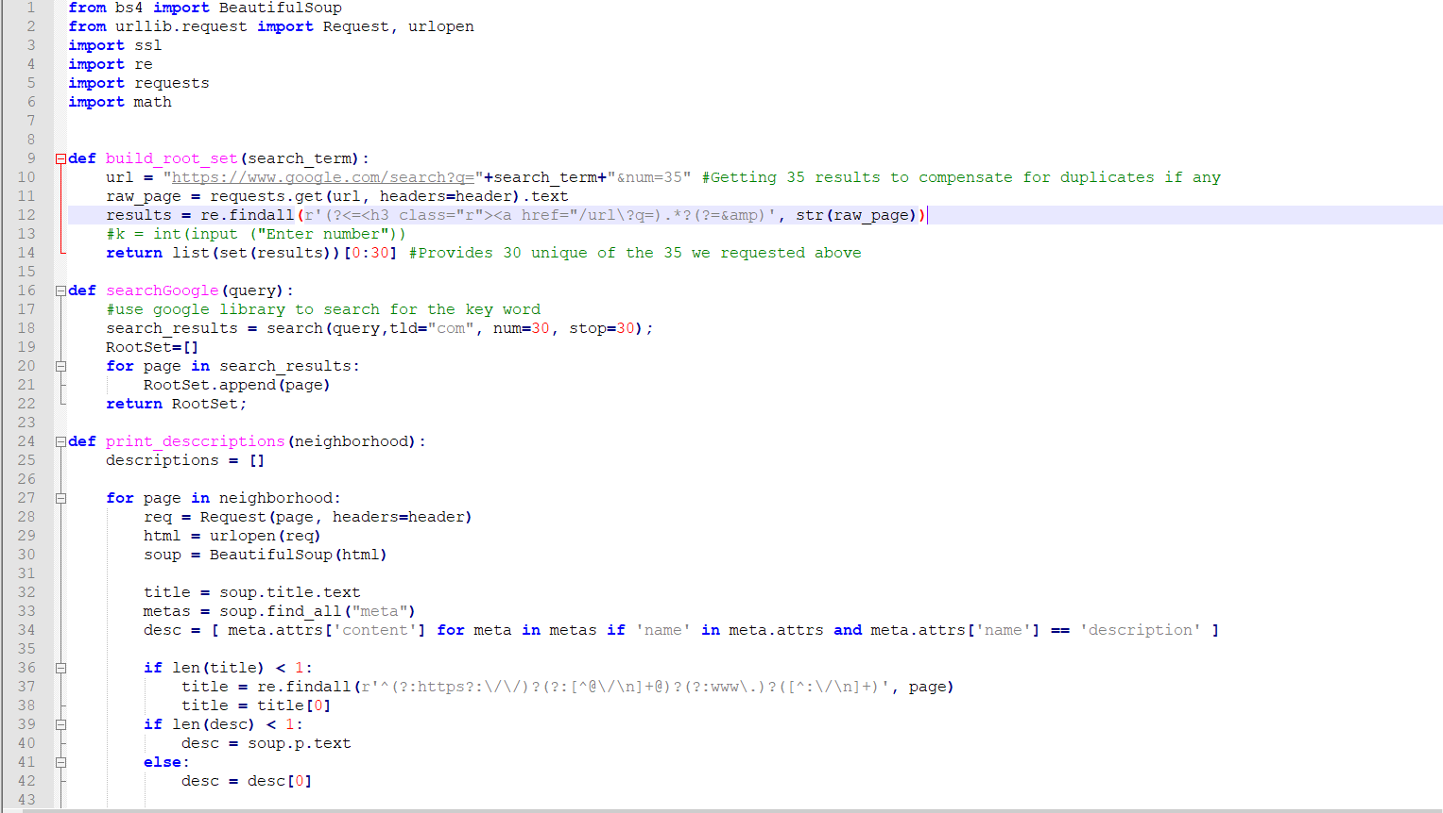
Source code for building the root and neighbourhood graph

Slide 18
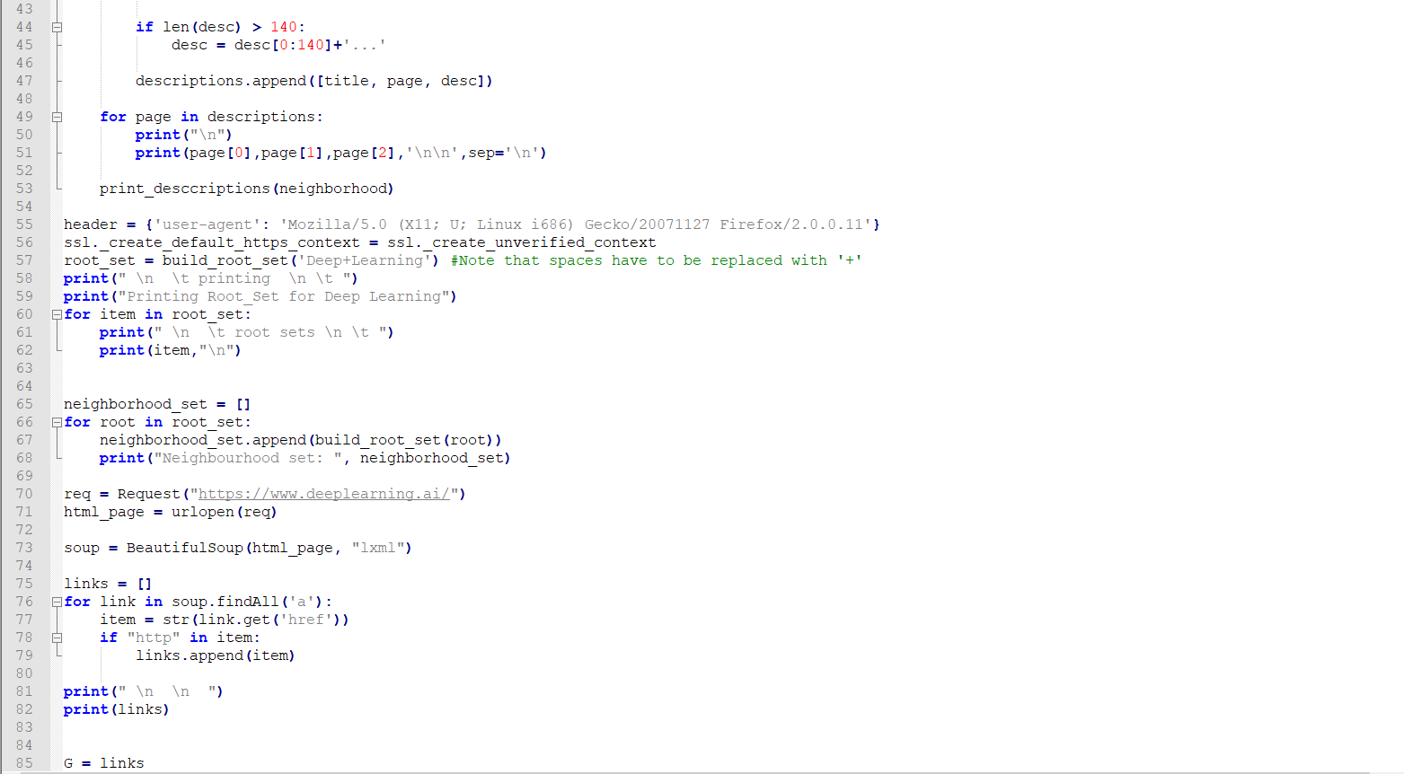

Slide 19
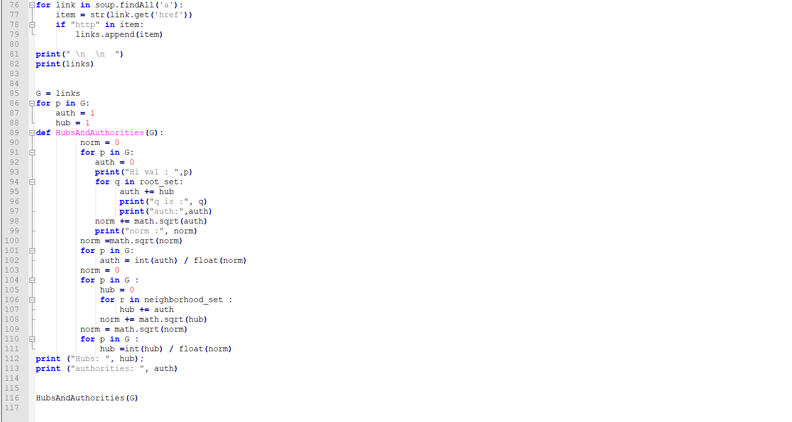

Slide 20
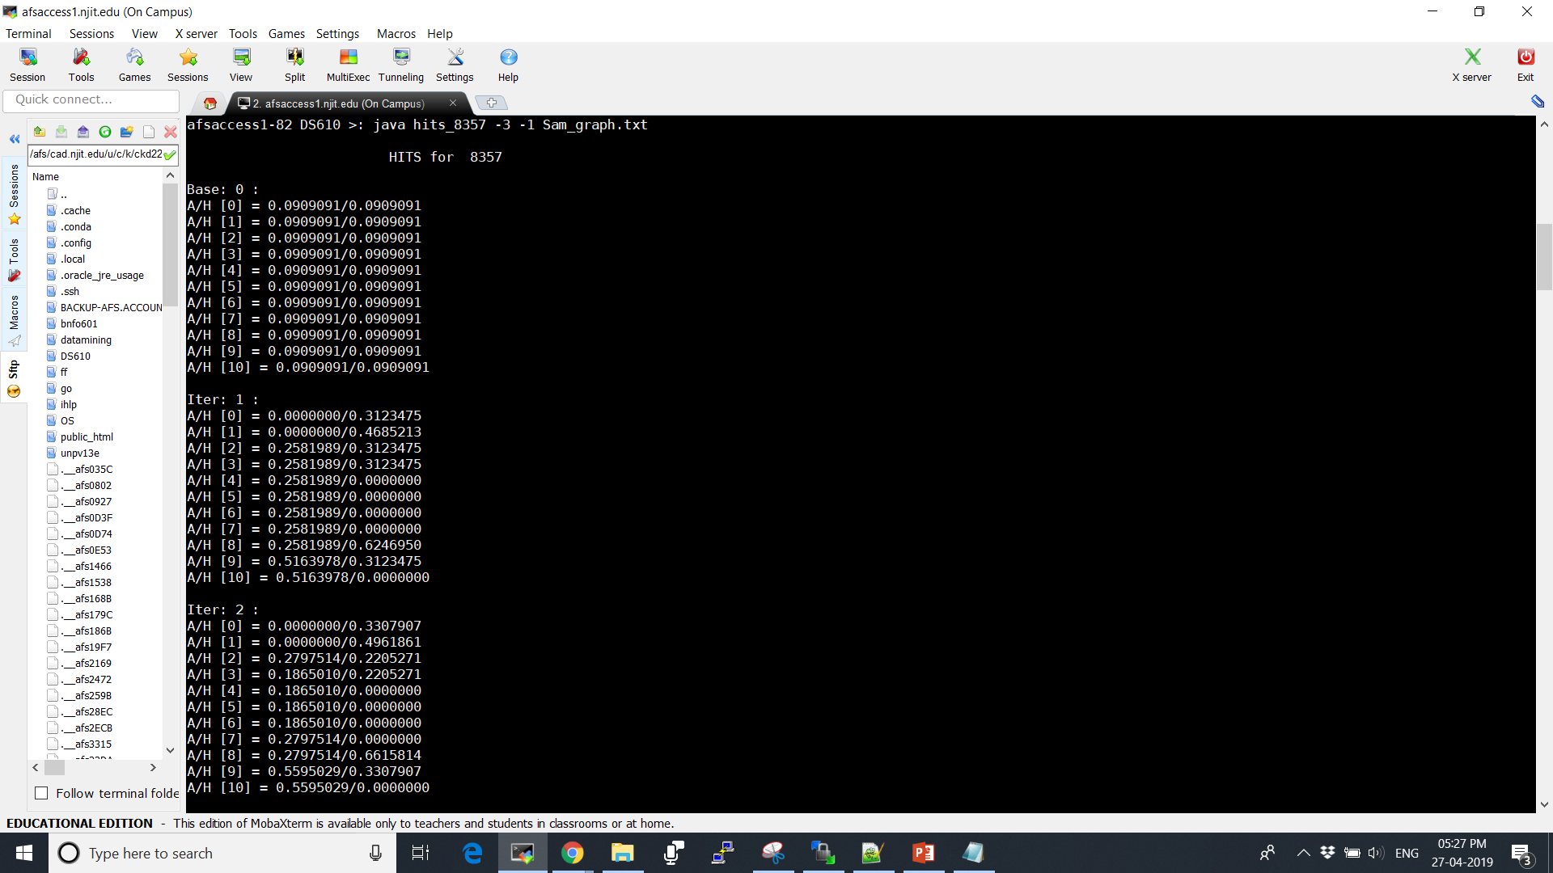
HITS Algorithm Implementation on the sample Graph(in java)

Slide 21
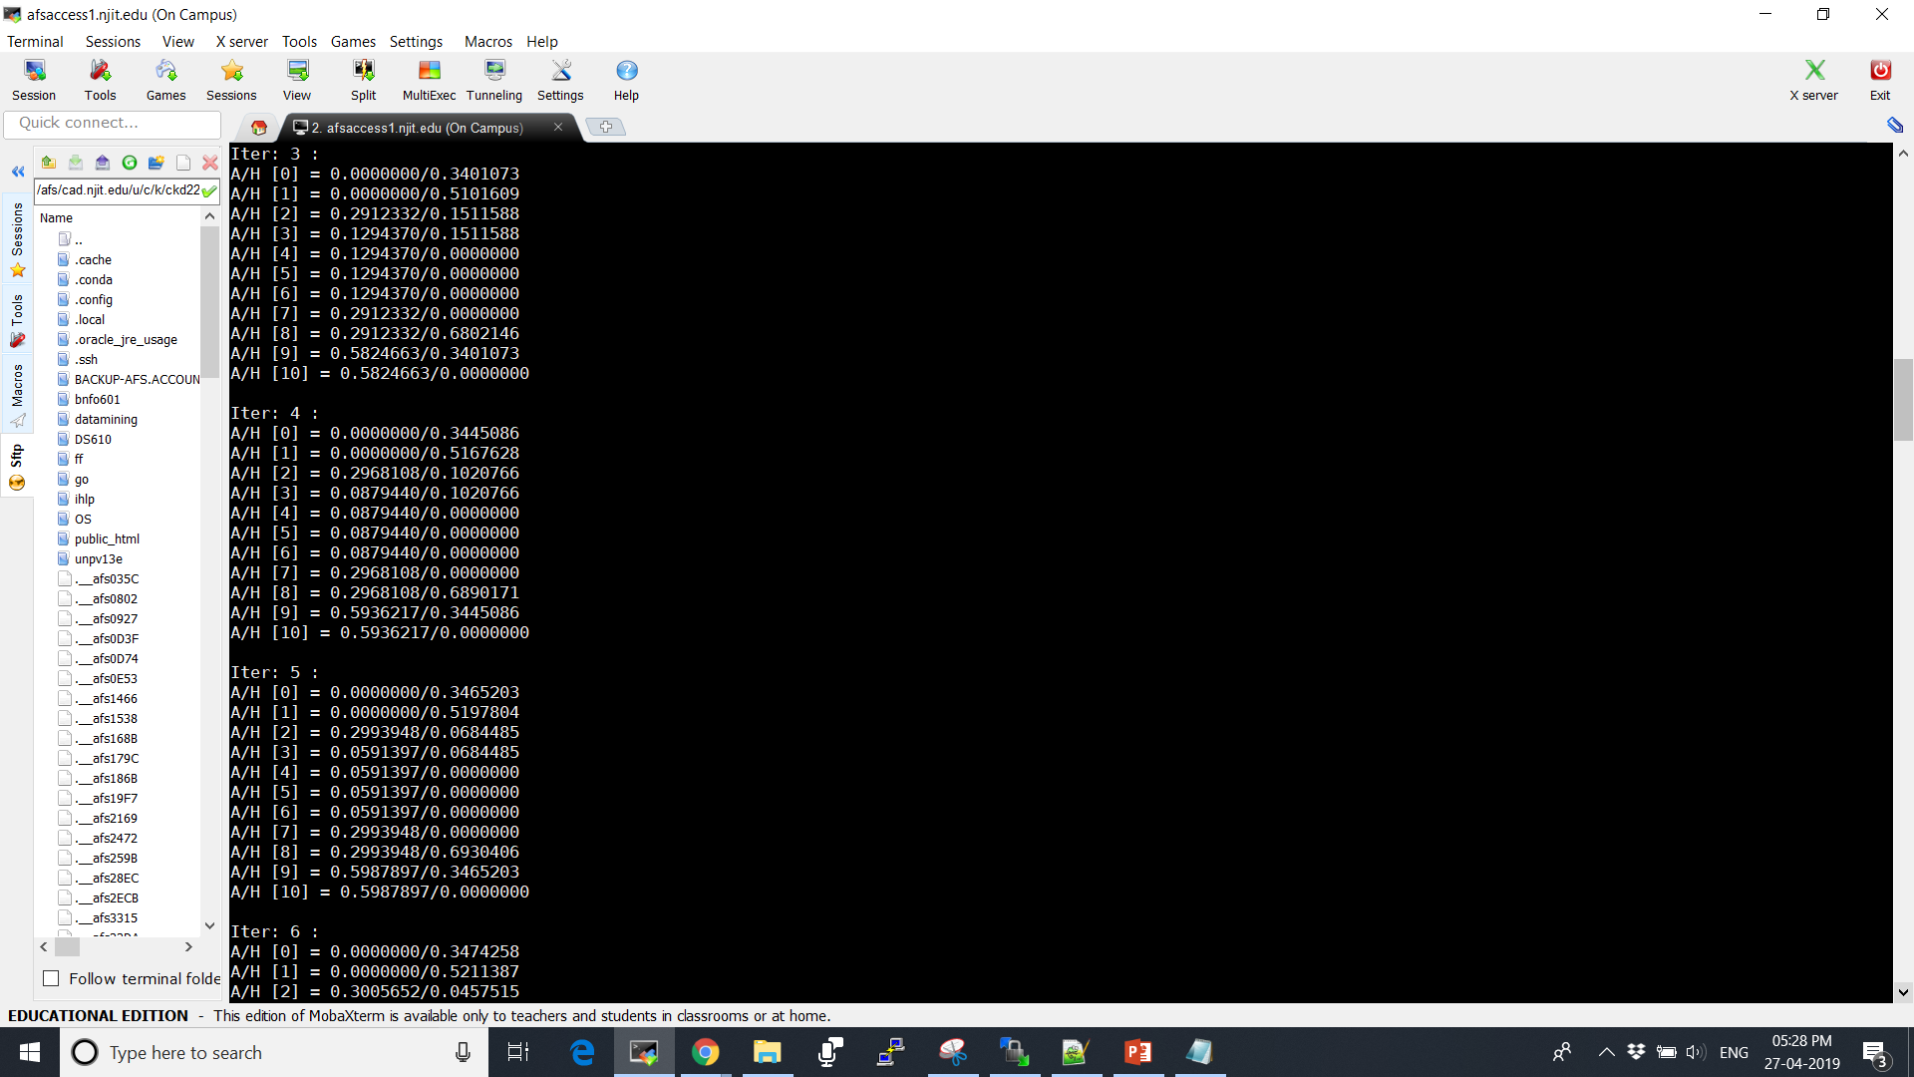

Slide 22


Slide 23
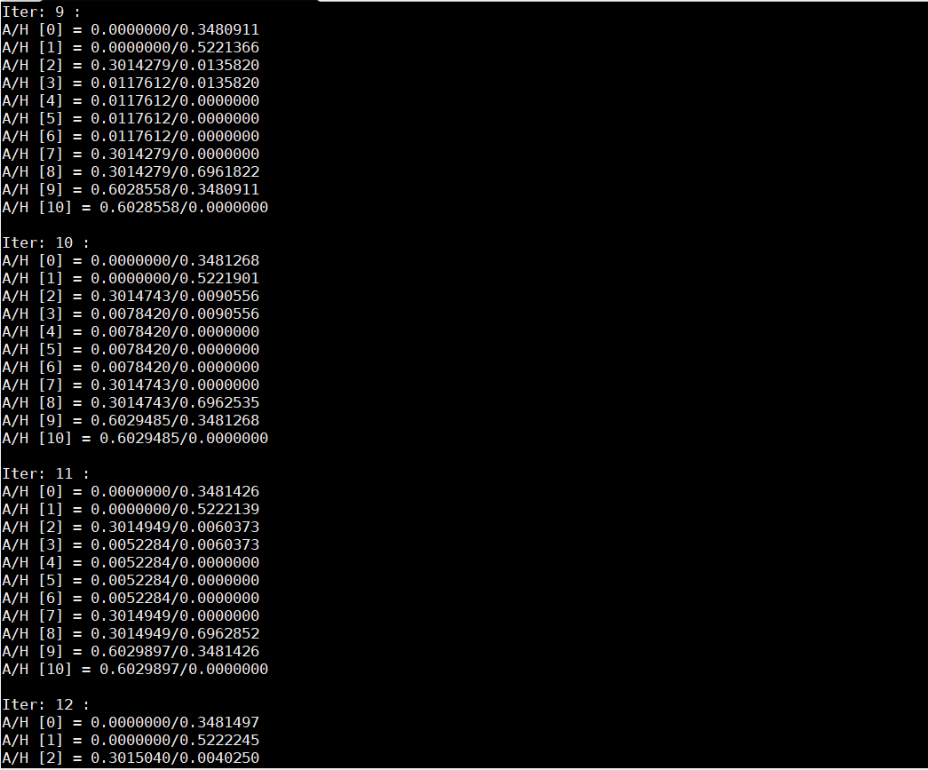

Slide 24
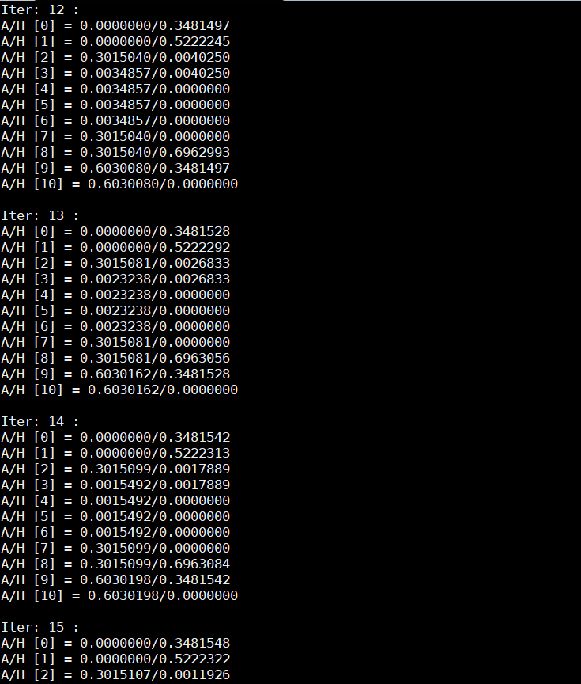

Slide 25
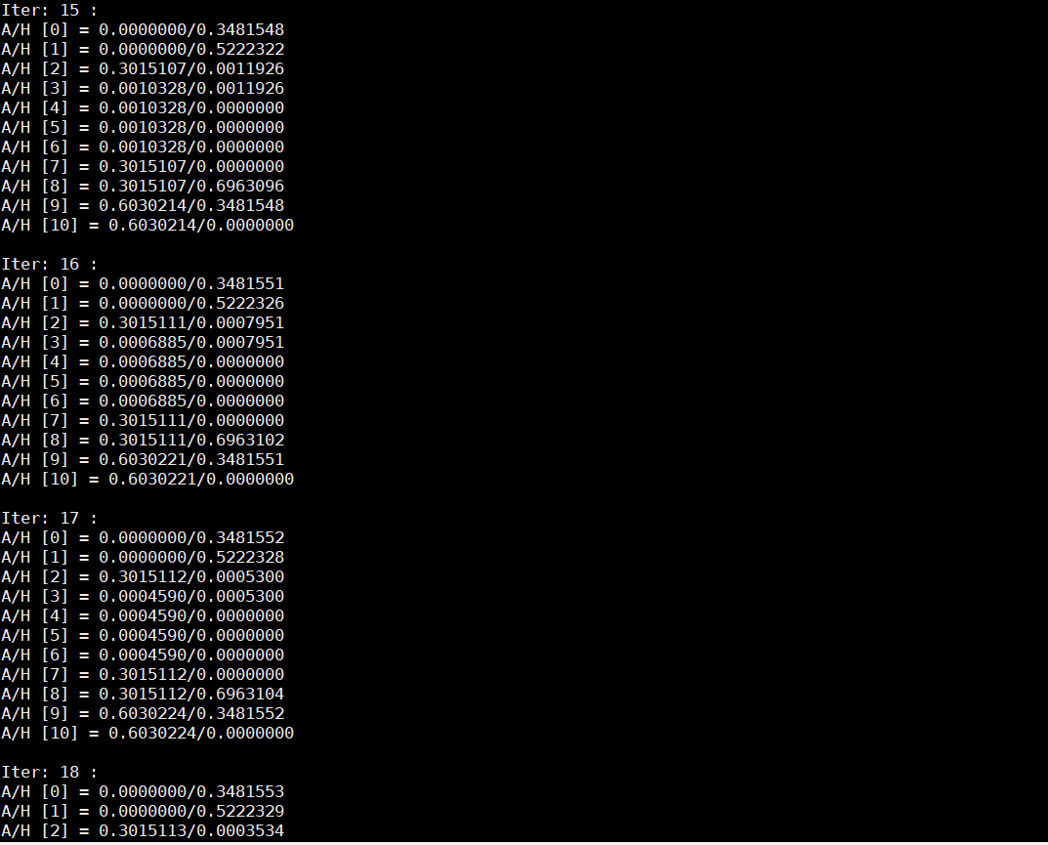

Slide 26
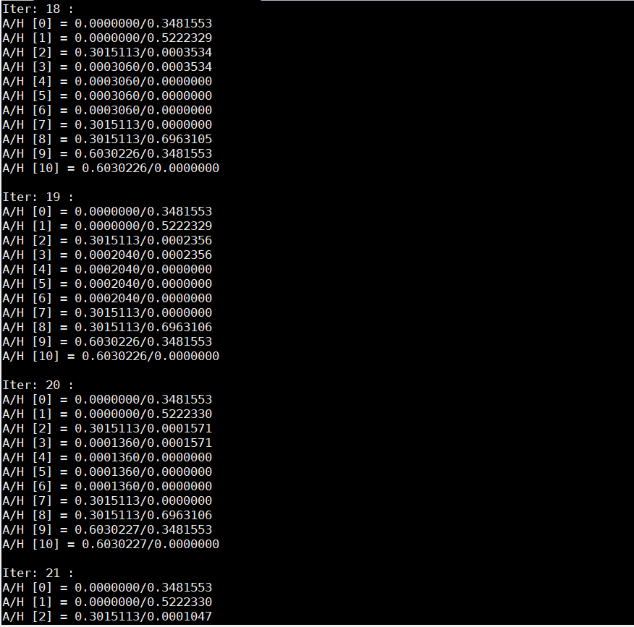

Slide 27
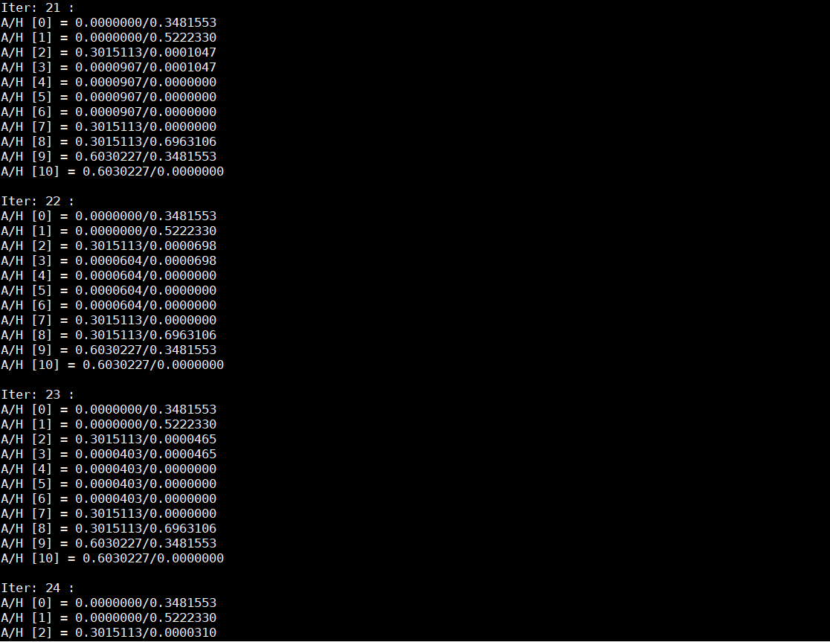

Slide 28
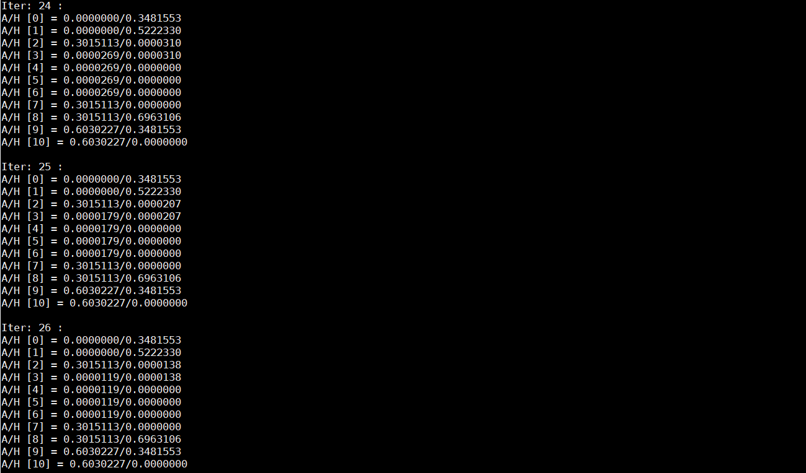
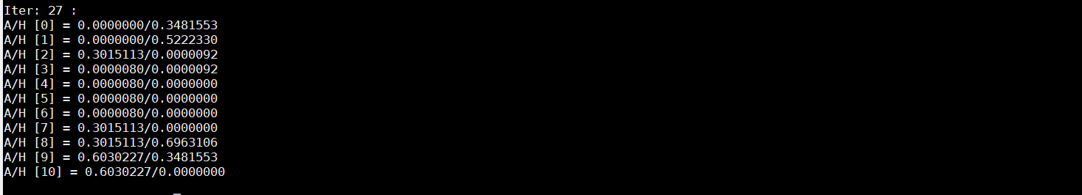

Slide 29
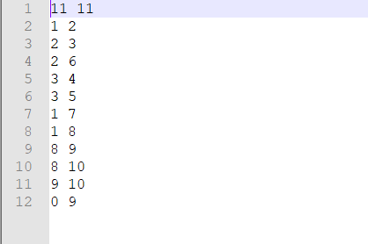
Sample Graph.txt

Slide 30
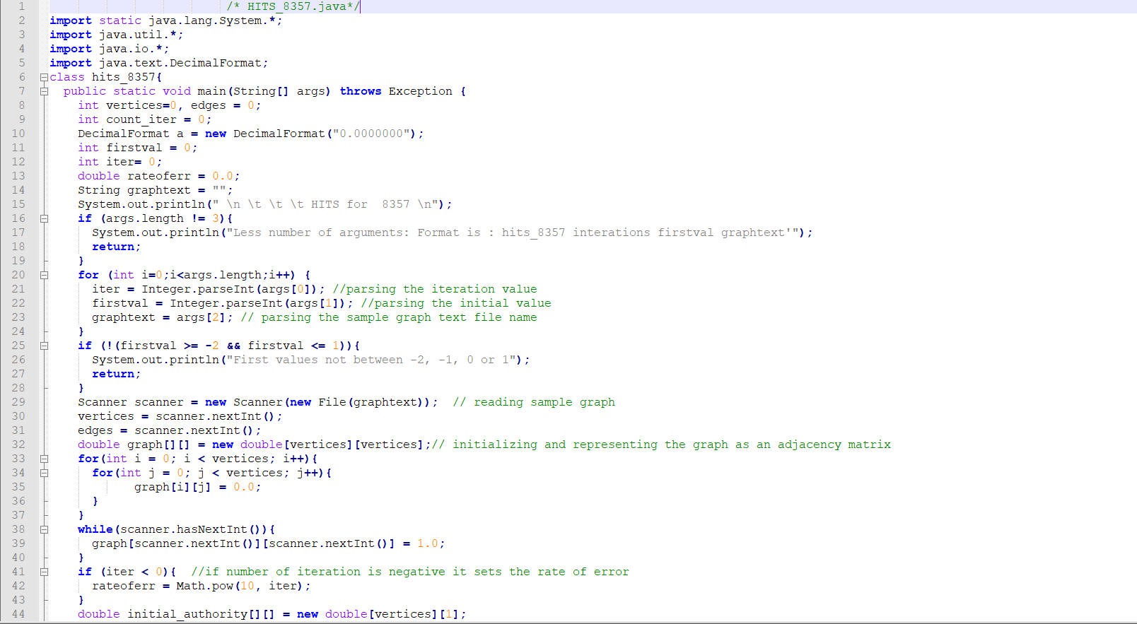
HITS Algorithm Implementation

Slide 31
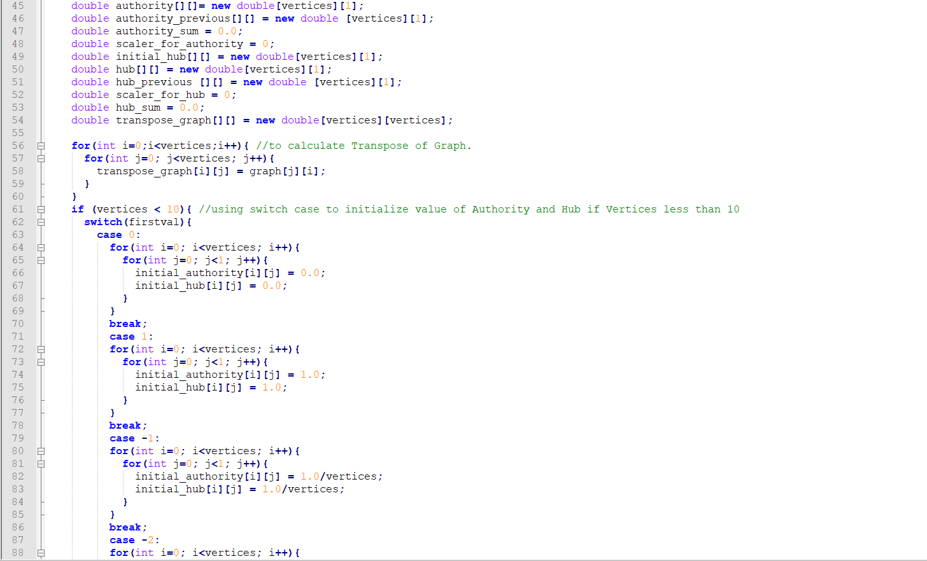

Slide 32
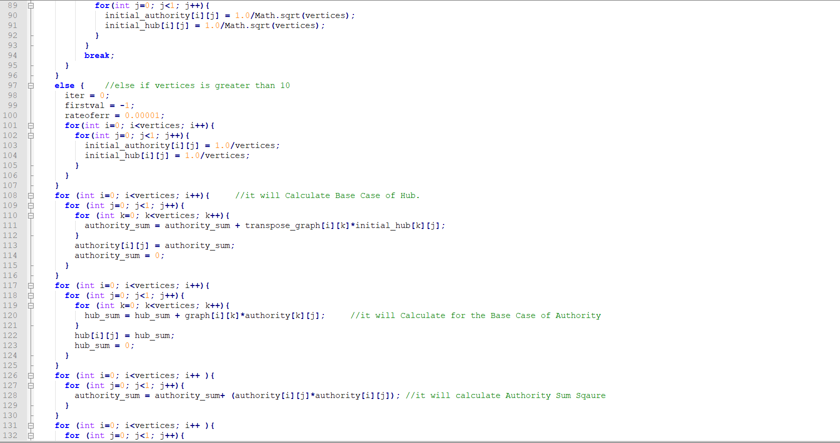

Slide 33
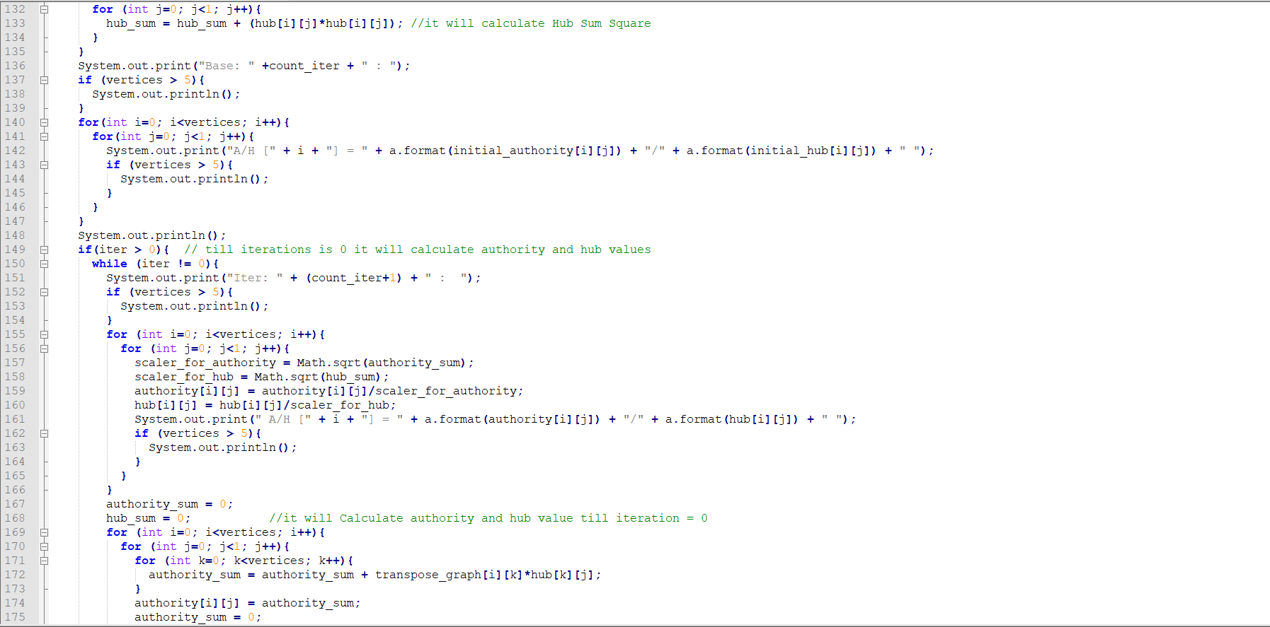

Slide 34
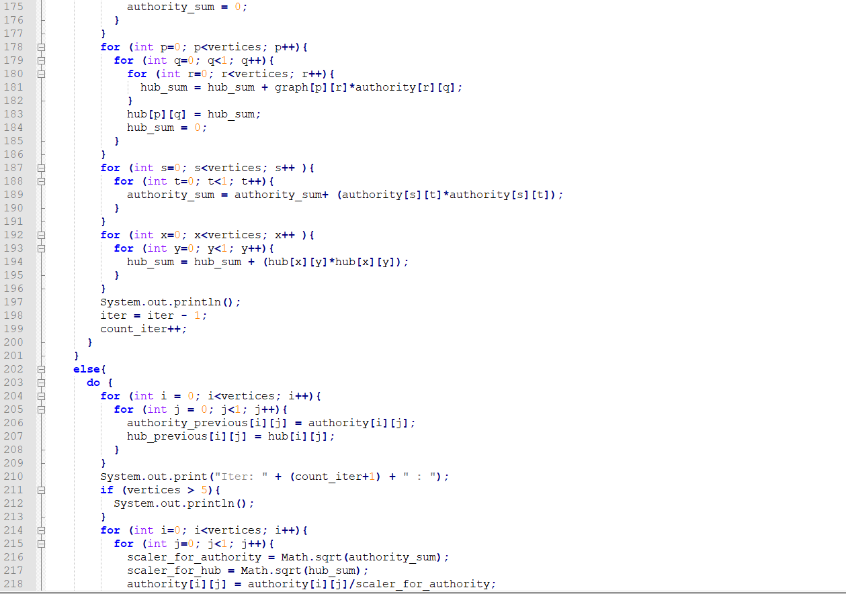

Slide 35
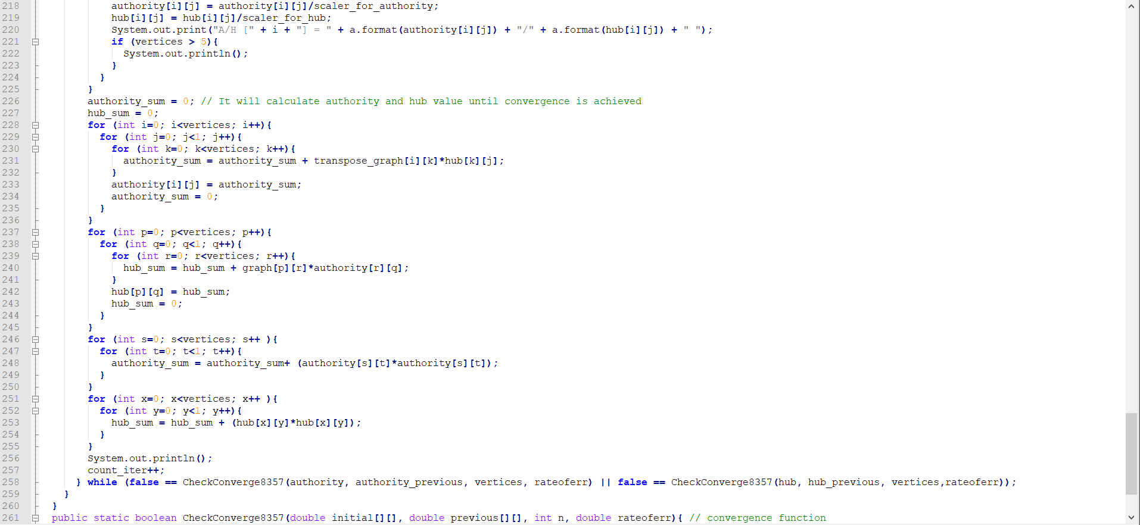
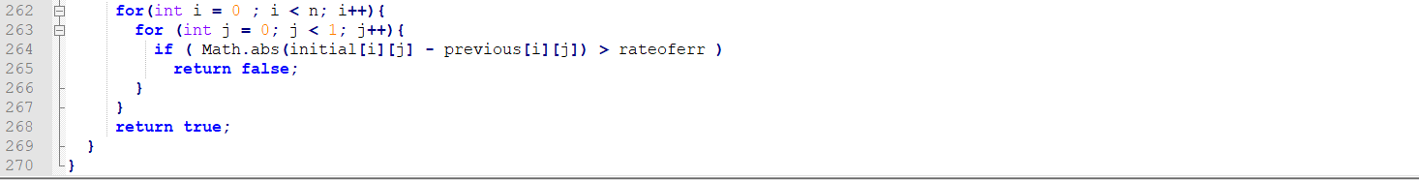

Slide 36
Problems Occurred:
Since in the first implementation of root and neighbourhood graphs, due to some errors that were showing the hits was not able to implement.
So, tried to implement the HITS algorithm using a sample graph and tried to implement it .

Slide 37
THANKYOU

